Slide 1
Endostar Spreader Sonic Files

Slide 2
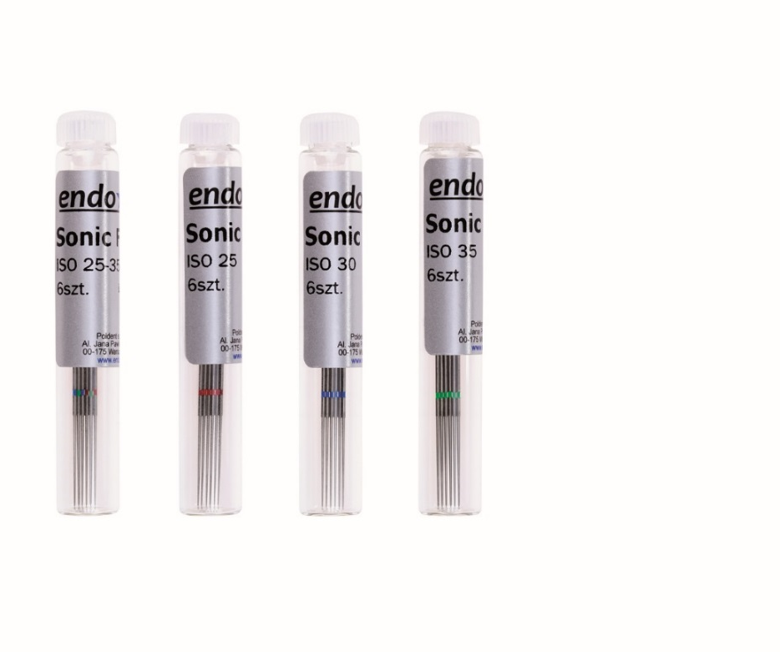
Endostar Spreader Sonic Files
NEW SONIC FILES FOR ALL ULTRASOUND DEVICES
Perfect for irrigation and root canal disinfection. Ultrasound phenomenon leads to an ideal root canal disinfection.
Endostar Spreader Sonic Files are made of special stainless steel.
Endostar Spreader Sonic Files Files are available in sizes 25, 30, 35. They all have the same length - 33 mm.
Endostar Spreader Sonic Files are not for regular root canal treatment.
.

Slide 3
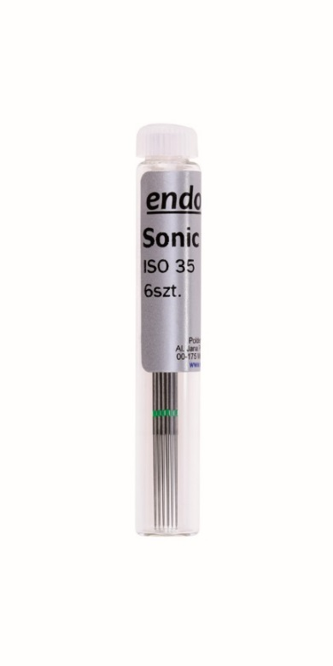
Indication
Ultrasound is ineffective in narrow, curved canals because file contact with root canal wall stops its effectiveness . Therefore, use Endostar Spreader Sonic Files in previously treated and expanded canals.
Such a method of root canal treatment are particularly preferred in the case of a massive infection of canals. It allows to remove the smear layer and open the dentinal tubules.
We do not recommend use of files with ultrasound as a reamer, because such action may cause steps and prevent its penetration.

Slide 4
Treatment rules
Endostar Spreader Sonic Files are designed for devices like ENDO - CHUCK 90, ENDO - CHUCK 120 °*
Ultrasonic files should be placed into root canal always in standby mode, approx. 2 mm shorter than the working length. Only then we could turn on ultrasound device.
It is recommended to rinse the canal with sodium hypochlorite
It is recommended to use ultrasound with minimum power to control the possibility of breakage the file in the canal.
File in canal should be passively move up and down (never by force) not to succumb to its curvature or stucked in the canal.
* Endo-Chuck 180 - not suitable for work using Endostar Spreader Sonic Files.

Slide 5
Work Instruction
Fill the root canal with wash solution - sodium hypochlorite.
Enter the file to canal - 2 mm shorter than the working length (leave a small gap, a small space at the tip/apex).
Turn on Ultrasound Device.
Activate hypochlorite for 20 seconds, moving with a small amplitude moves (1-2 mm) with a file Endostar Spreader Sonic Files in the canal. Replace the fresh hypochlorite (about 1-2 ml). Reactivate the solution for 20 seconds. Again, replace with a fresh solution. For the third time activate hypochlorite for 20 seconds.

Slide 6
Action
In work with ultrasound files following phenomena are used :
File vibrations cause accurate cleaning and disinfection.
Acoustic turbulence of wash solution mechanically cleans the main and side canals.
Cavitation causes the formation of gas bubbles in the fluid, which exhibit bactericidal and accelerate the hydrolysis of the pulp.
The sonic energy causes the temperature of the fluid in the canal, increasing its lytic and bactericidal action.

Slide 7
Offer
Endostar Spreader Sonic Files are available in packs of 6 items of the same size: 25, 30, 35 Also available as assotred package. They are packed 2 items of each size.
ESSF002533 – Endostar Spreader Sonic Files, size. 25, 6 items
ESSF003033 – Endostar Spreader Sonic Files, size 30, 6 items
ESSF003533 – Endostar Spreader Sonic Files, size 35, 6 items
ESSF253533 – Endostar Spreader Sonic Files, size 25-35, 6 items / 2 items of each size

Slide 8
Endostar Spreader Sonic Files
www.endostar.eu

